Slide 1

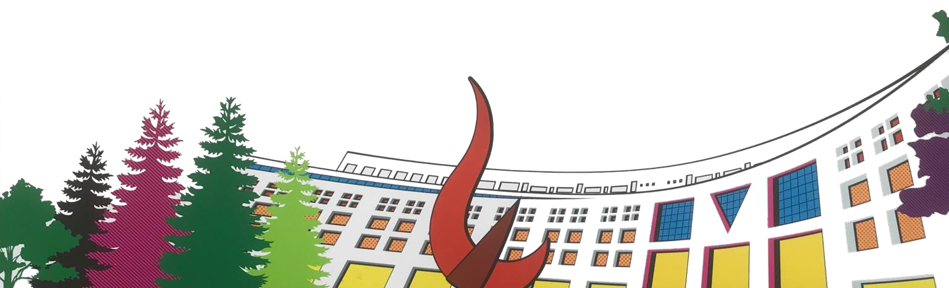


ML/DL for Everyone Season2
with
Lab 11-0 CNN Basics
Convolution
Code: https://github.com/deeplearningzerotoall/TensorFlow Slides: http://bit.ly/2LQMKvk
Lecturer: 이진원/JinWon Lee(jwlee.ml25@gmail.com)

Slide 2
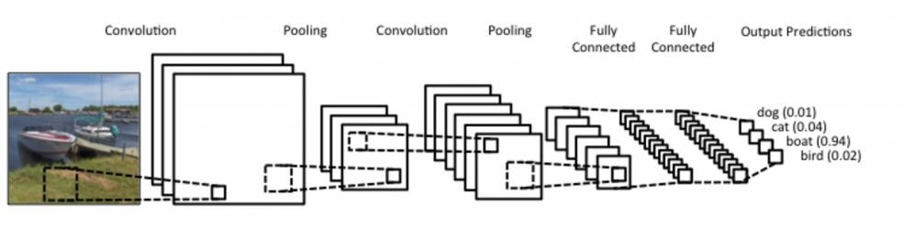
Convolutional Neural Network
Most widely used for image classification.
Generally, it consists of convolution layer, pooling layer and fully- connected layer.
Weight(parameter, filter, kernel) sharing
Convolution, Pooling layer – feature extraction
Fully-connected layer – classification
https://www.kdnuggets.com/2015/11/understanding-convolutional-neural-networks-nlp.html

Slide 3
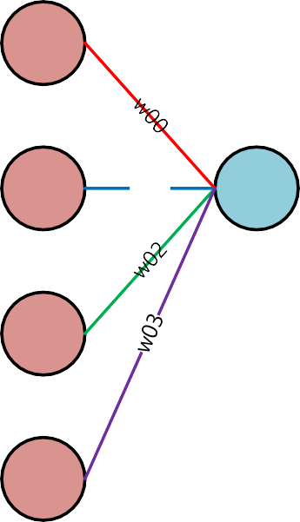
Dense Layer vs 1-D Convolution Layer
Dense Layer(Fully Connected Layer)
𝑦0 = 𝑥0 ∙ 𝑤00 + 𝑥1 ∙ 𝑤01 + 𝑥2 ∙ 𝑤02 + 𝑥3 ∙ 𝑤03
x0
x1
w01
y0
x2
x3

Slide 4
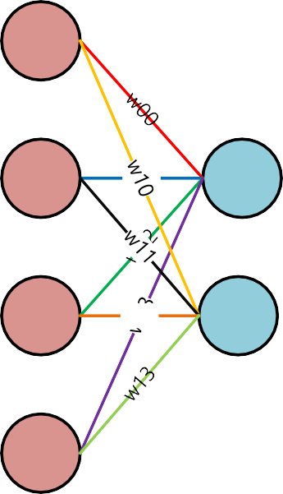
Dense Layer vs 1-D Convolution Layer
Dense Layer(Fully Connected Layer)
𝑦0 = 𝑥0 ∙ 𝑤00 + 𝑥1 ∙ 𝑤01 + 𝑥2 ∙ 𝑤02 + 𝑥3 ∙ 𝑤03
𝑦1 = 𝑥0 ∙ 𝑤10 + 𝑥1 ∙ 𝑤11 + 𝑥2 ∙ 𝑤12 + 𝑥3 ∙ 𝑤13
x0
x1
w01
y0
x2
w12
y1
x3

Slide 5
Dense Layer vs 1-D Convolution Layer
1-D Convolution Layer
𝑦0 = 𝑥0 ∙ 𝑤0 + 𝑥1 ∙ 𝑤1 + 𝑥2 ∙ 𝑤2
x0
x1
w1
y0
x2
x3

Slide 6
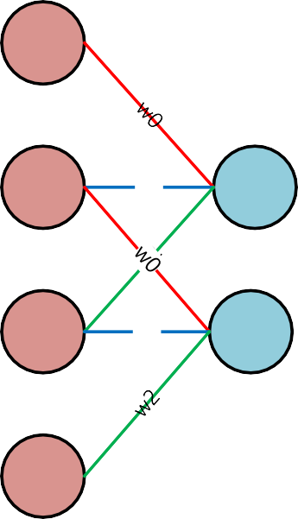
Dense Layer vs 1-D Convolution Layer
1-D Convolution Layer
𝑦0 = 𝑥0 ∙ 𝑤0 + 𝑥1 ∙ 𝑤1 + 𝑥2 ∙ 𝑤2
𝑦0 = 𝑥1 ∙ 𝑤0 + 𝑥2 ∙ 𝑤1 + 𝑥3 ∙ 𝑤2
x0
x1
w1
y0
x2
w1
y1
x3

Slide 7
Dense Layer vs 1-D Convolution Layer
1-D Convolution Layer
Weight sharing
𝑦0 = 𝑥0 ∙ 𝑤0 + 𝑥1 ∙ 𝑤1 + 𝑥2 ∙ 𝑤2
𝑦0 = 𝑥1 ∙ 𝑤0 + 𝑥2 ∙ 𝑤1 + 𝑥3 ∙ 𝑤2
&
Locally connected
x0
x1
w1
y0
x2
w1
y1
x3

Slide 8
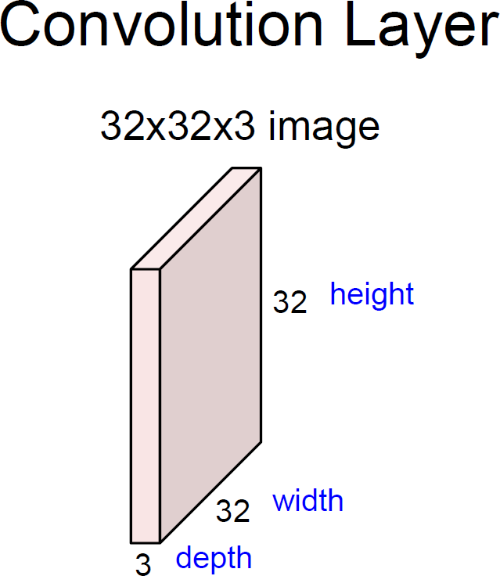
2D Convolution Layer
channel
Slide Credit : Stanford CS231n

Slide 9
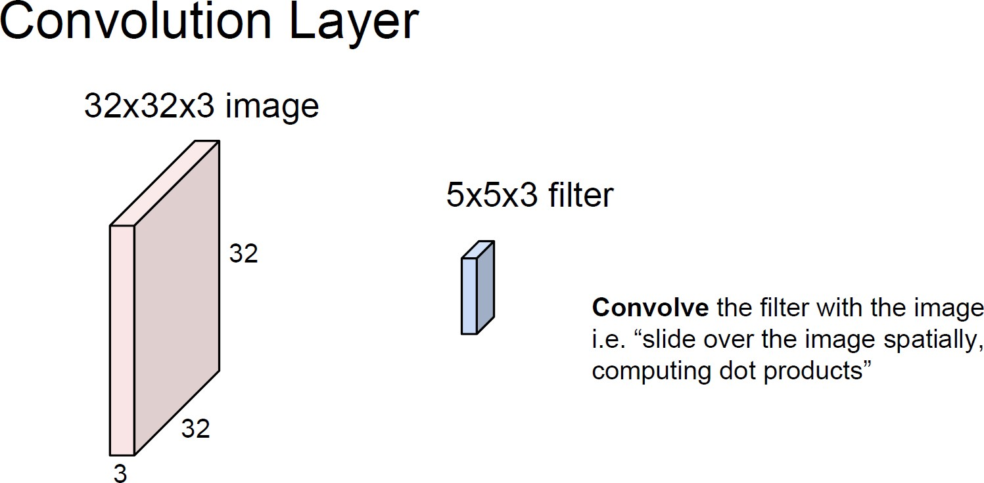
2D Convolution Layer
Slide Credit : Stanford CS231n

Slide 10
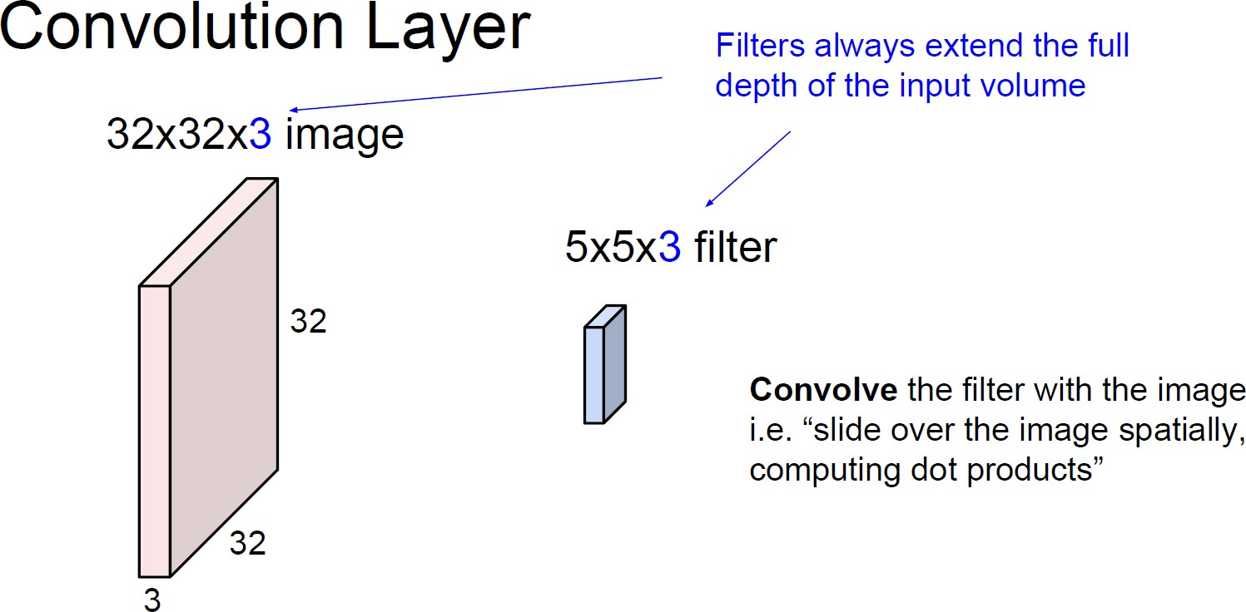
2D Convolution Layer
channel
Slide Credit : Stanford CS231n

Slide 11





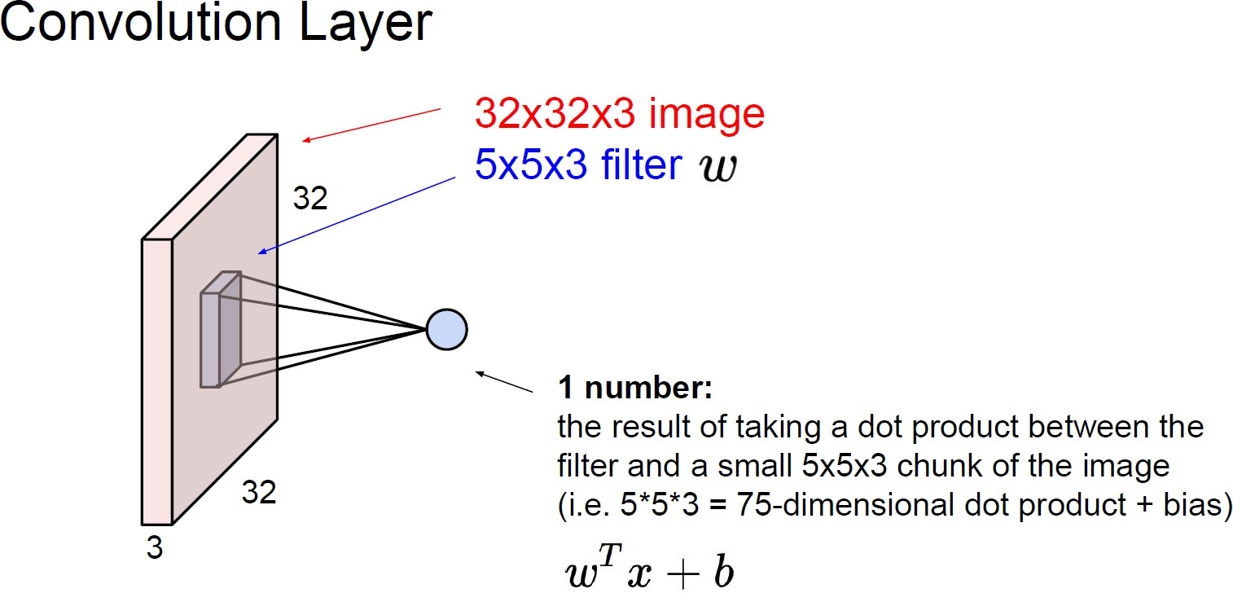
2D Convolution Layer
x0
x1
w1
y0
x2
x3
Slide Credit : Stanford CS231n

Slide 12

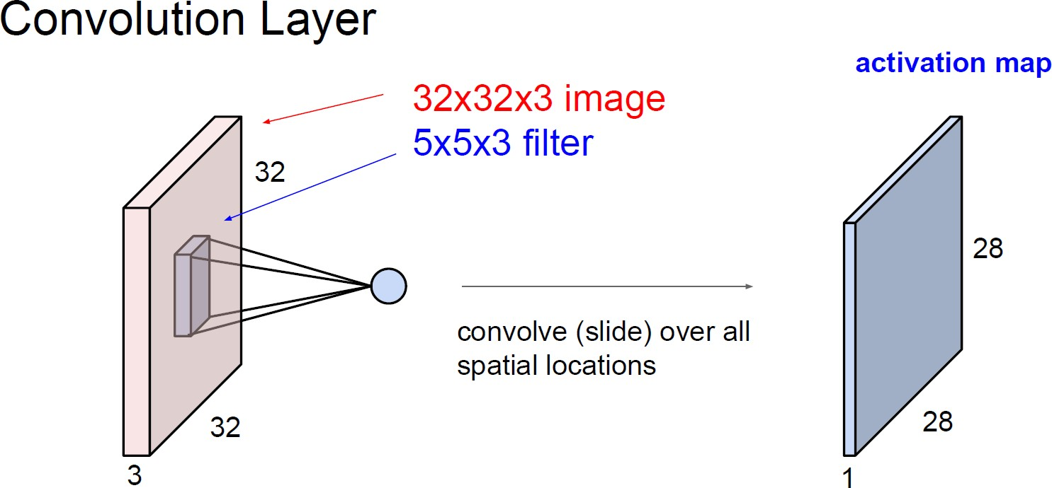
2D Convolution Layer
x0
x1
w1
y0
x2
w1
y1
x3
Feature map Activation map
Slide Credit : Stanford CS231n

Slide 13
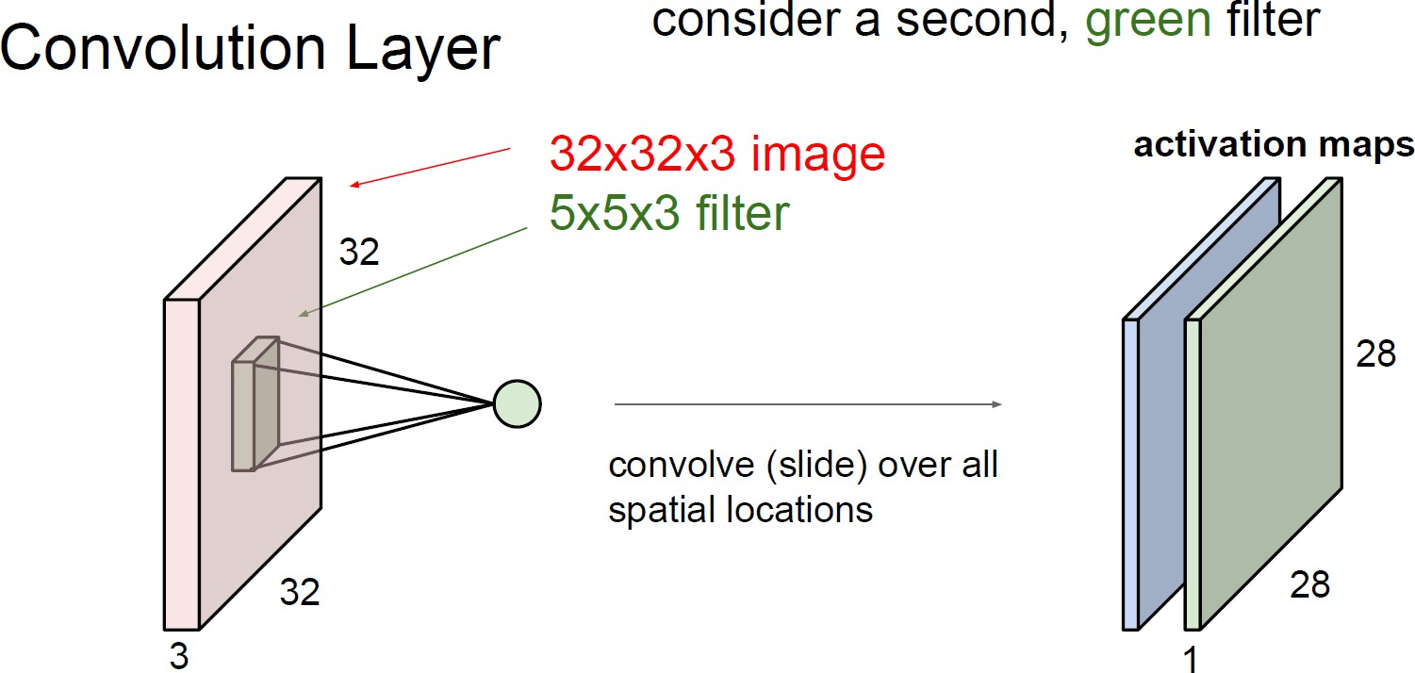
2D Convolution Layer
Feature maps Activation maps
Slide Credit : Stanford CS231n

Slide 14
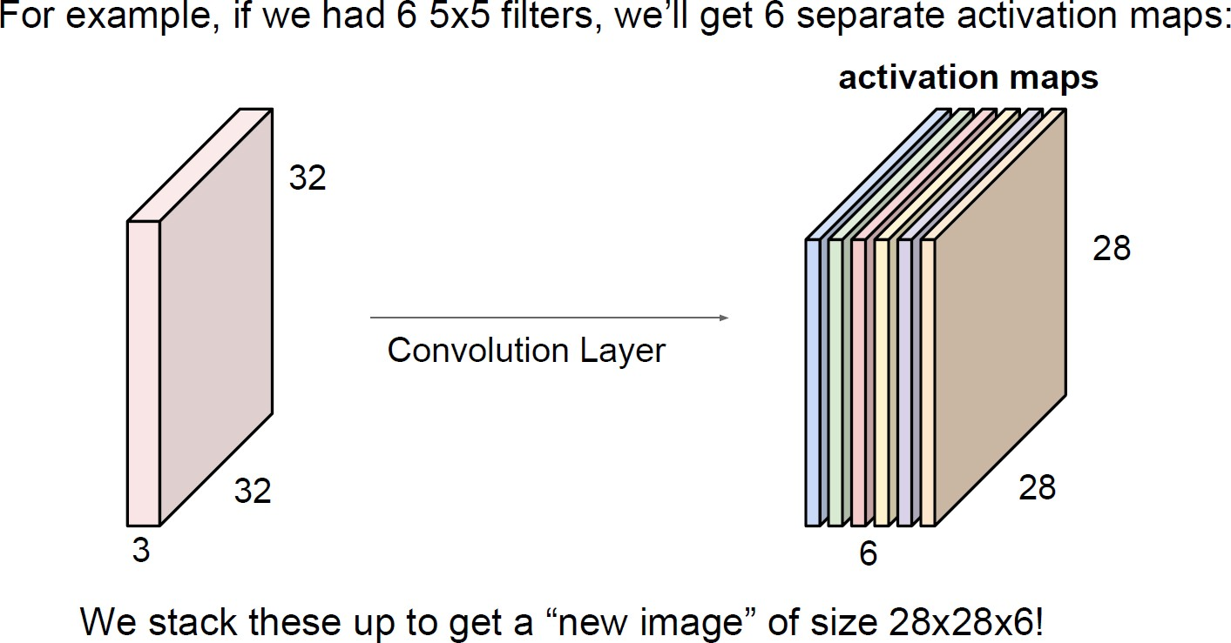
2D Convolution Layer
Feature maps Activation maps
Slide Credit : Stanford CS231n

Slide 15
2D Convolution Layer – Computation
1x1 + 1x0 + 1x1 + 0x0 + 1x1 + 1x0 + 0x1 + 0x0 + 1x1 = 4
1 | 1 | 1 | 0 | 0
0 | 1 | 1 | 1 | 0
0 | 0 | 1 | 1 | 1
0 | 0 | 1 | 1 | 0
0 | 1 | 1 | 0 | 0
1 | 0 | 1 | = | 4
0 | 1 | 0
1 | 0 | 1
convolution
filter
Output feature map
Input feature map

Slide 16
2D Convolution Layer – Computation
1x1 + 1x0 + 0x1 + 1x0 + 1x1 + 1x0 + 0x1 + 1x0 + 1x1 = 3
1 | 1 | 1 | 0 | 0
0 | 1 | 1 | 1 | 0
0 | 0 | 1 | 1 | 1
0 | 0 | 1 | 1 | 0
0 | 1 | 1 | 0 | 0
1 | 0 | 1 | = | 4 | 3
0 | 1 | 0
1 | 0 | 1
convolution
filter
Output feature map
Input feature map

Slide 17
2D Convolution Layer – Computation
1x1 + 0x0 + 0x1 + 1x0 + 1x1 + 0x0 + 1x1 + 1x0 + 1x1 = 4
1 | 1 | 1 | 0 | 0
0 | 1 | 1 | 1 | 0
0 | 0 | 1 | 1 | 1
0 | 0 | 1 | 1 | 0
0 | 1 | 1 | 0 | 0
1 | 0 | 1 | = | 4 | 3 | 4
0 | 1 | 0
1 | 0 | 1
convolution
filter
Output feature map
Input feature map

Slide 18
2D Convolution Layer – Computation
0x1 + 1x0 + 1x1 + 0x0 + 0x1 + 1x0 + 0x1 + 0x0 + 1x1 = 2
1 | 1 | 1 | 0 | 0
0 | 1 | 1 | 1 | 0 | convolution | 1 | 0 | 1
0 | 0 | 1 | 1 | 1 |  | 0 | 1 | 0
0 | 0 | 1 | 1 | 0 |  | 1 | 0 | 1
0 | 1 | 1 | 0 | 0
4 | 3 | 4
2
=
filter
Output feature map
Input feature map

Slide 19
2D Convolution Layer – Computation
1x1 + 1x0 + 1x1 + 0x0 + 1x1 + 1x0 + 0x1 + 1x0 + 1x1 = 4
1 | 1 | 1 | 0 | 0
0 | 1 | 1 | 1 | 0 | convolution | 1 | 0 | 1
0 | 0 | 1 | 1 | 1 |  | 0 | 1 | 0
0 | 0 | 1 | 1 | 0 |  | 1 | 0 | 1
0 | 1 | 1 | 0 | 0
=
4
3
4
2
4
filter
Output feature map
Input feature map

Slide 20
2D Convolution Layer – Computation
1x1 + 1x0 + 0x1 + 1x0 + 1x1 + 1x0 + 1x1 + 1x0 + 0x1 = 3
1 | 1 | 1 | 0 | 0
0 | 1 | 1 | 1 | 0 | convolution | 1 | 0 | 1
0 | 0 | 1 | 1 | 1 |  | 0 | 1 | 0
0 | 0 | 1 | 1 | 0 |  | 1 | 0 | 1
0 | 1 | 1 | 0 | 0
4 | 3 | 4
2 | 4 | 3
=
filter
Output feature map
Input feature map

Slide 21
2D Convolution Layer – Computation
0x1 + 0x0 + 1x1 + 0x0 + 0x1 + 1x0 + 0x1 + 1x0 + 1x1 = 2
1 | 1 | 1 | 0 | 0
0 | 1 | 1 | 1 | 0
0 | 0 | 1 | 1 | 1
0 | 0 | 1 | 1 | 0
0 | 1 | 1 | 0 | 0
1 | 0 | 1 | = | 4 | 3 | 4
0 | 1 | 0 |  | 2 | 4 | 3
1 | 0 | 1 |  | 2
convolution
filter
Output feature map
Input feature map

Slide 22
2D Convolution Layer – Computation
0x1 + 1x0 + 1x1 + 0x0 + 1x1 + 1x0 + 1x1 + 1x0 + 0x1 = 3
1 | 1 | 1 | 0 | 0
0 | 1 | 1 | 1 | 0
0 | 0 | 1 | 1 | 1
0 | 0 | 1 | 1 | 0
0 | 1 | 1 | 0 | 0
1 | 0 | 1 | = | 4 | 3 | 4
0 | 1 | 0 |  | 2 | 4 | 3
1 | 0 | 1 |  | 2 | 3
convolution
filter
Output feature map
Input feature map

Slide 23
2D Convolution Layer – Computation
1x1 + 1x0 + 1x1 + 1x0 + 1x1 + 0x0 + 1x1 + 0x0 + 0x1 = 4
1 | 1 | 1 | 0 | 0
0 | 1 | 1 | 1 | 0
0 | 0 | 1 | 1 | 1
0 | 0 | 1 | 1 | 0
0 | 1 | 1 | 0 | 0
1 | 0 | 1 | = | 4 | 3 | 4
0 | 1 | 0 |  | 2 | 4 | 3
1 | 0 | 1 |  | 2 | 3 | 4
convolution
filter
Output feature map
Input feature map

Slide 24
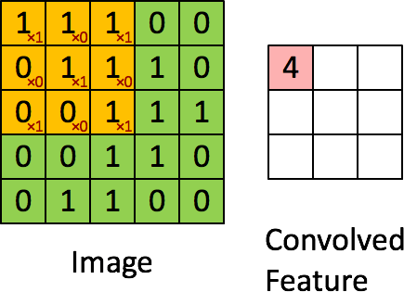
2D Convolution Layer – Computation

Slide 25
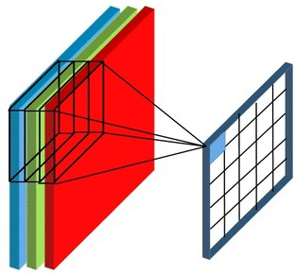
2D Convolution Layer
– Multi Channel, Many Filters
-
1 0
0
0
-
1 0
1 0 1 ₁
0
0
1
0
1
1
1
1
-
1 1
-
0
1
1
0
₀ 1
0 1 0
1
1
1 1 0
0
0
0
-
1 -
1
1
1
1
1
1
0
-
1 0
3 0 1
0
1
1
0
₀ 0
1 0 1
=
0
1 1 1
1
0 -
1 -
1
0
0
0
1
0
-
2 0 2
0
0
1
1
0
0 1 1 1 ₁
0
3
1
0
0
1
1
1
0 2 3
0
0
1
1
convolution
0
0 1 1 0 ₀
0
1
0
1
1
0
-
1 0
-
1
1
1
0
0
-
1 0
0 1 1 0 0
1 0 1
0
1
0
-
1 1
0
0 -1 0
1
0
0
-
0
-
1 0
1 0 1
# of filters : 2
Input channel : 3
Output channel : 2
https://predictiveprogrammer.com/famous-convolutional-neural-network-architectures-1/

Slide 26
2D Convolution Layer
– Multi Channel, Many Filters
1 | 0 | 1
0 | 1 | 0
1 | 0 | 1
1 | 1 | 1 | 0 | 0
0 | 1 | 1 | 1 | 0
0 | 0 | 1 | 1 | 1
0 | 0 | 1 | 1 | 0
0 | 1 | 1 | 0 | 0
convolution
convolution
1 | 0 | 1
0 | -1 | 0
1 | 0 | 1
3 | 0 | 1
-2 | 0 | 2
0 | 2 | 3
0 | -1 | 0
-1 | 1 | -1
0 | -1 | 0
0 | 1 | 1 | 0 | 1
0 | 1 | 1 | 0 | 0
0 | 0 | 1 | 1 | 0
0 | 0 | 1 | 1 | 1
1 | 1 | 1 | 0 | 0
convolution
convolution
0 | 1 | 0
-1 | -1 | 0
0 | 1 | 0
1 | -1 | 1
0 | -1 | -1
3 | 1 | 0
-1 | 0 | 0
0 | 1 | 0
0 | 0 | -1
1 | 1 | 1 | 1 | 0
1 | 1 | 1 | 1 | 0
0 | 0 | 0 | 1 | 1
0 | 1 | 1 | 1 | 0
0 | 1 | 1 | 0 | 0
convolution
-1 | 0 | -1
0 | 1 | 0
-1 | 0 | -1
Output channel : 2
convolution
Input channel : 3
# of filters : 2

Slide 27
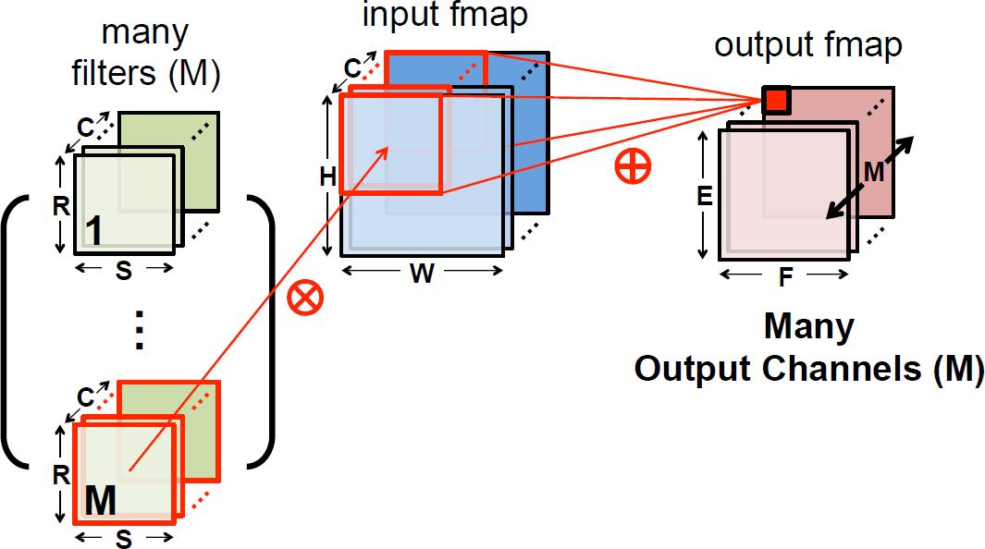
2D Convolution Layer
Slide Credit : http://eyeriss.mit.edu/tutorial.html

Slide 28
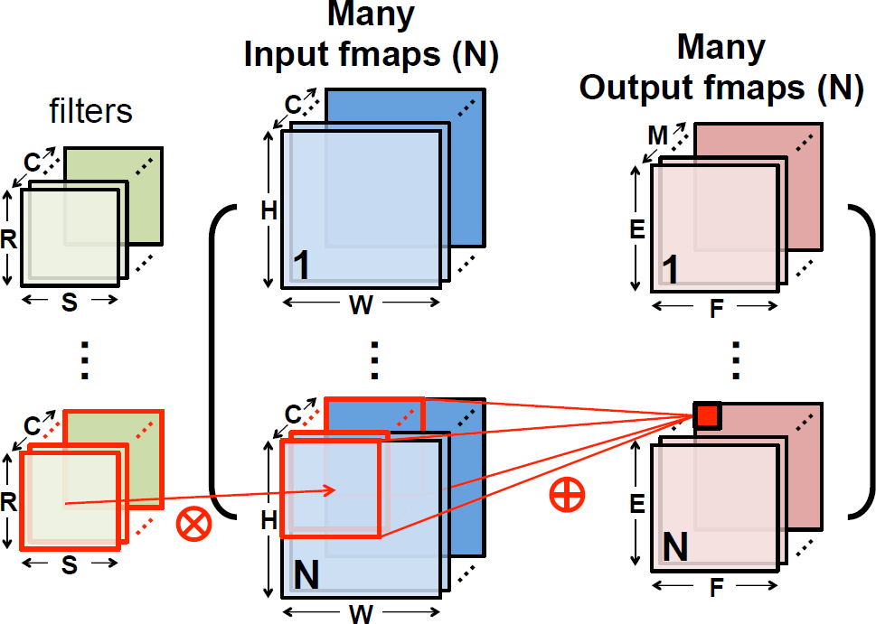
2D Convolution Layer – 4D Tensors
Slide Credit : http://eyeriss.mit.edu/tutorial.html

Slide 29
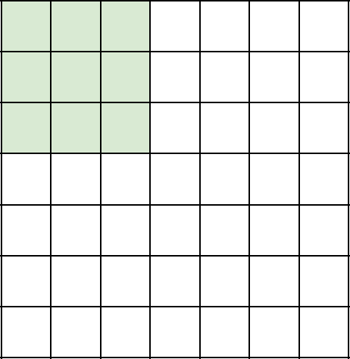
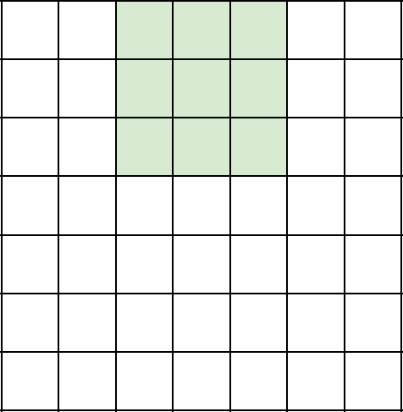
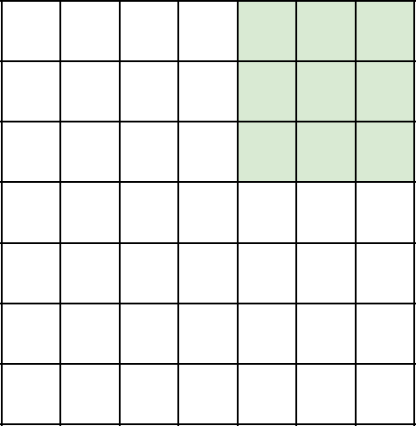
Options of Convolution
Stride – How far to go to the right or the bottom to perform the next convolution
Ex) 7x7 input, 3x3 convolution filter with stride 2 → 3x3 output
Slide Credit : Stanford CS231n

Slide 30
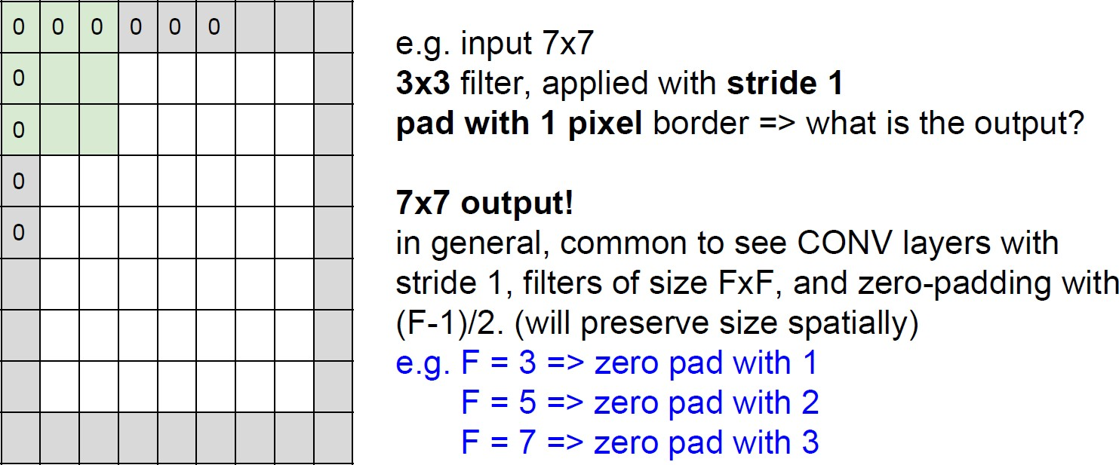
Options of Convolution
Zero Padding
Slide Credit : Stanford CS231n

Slide 31
Activation Function
ReLU
3 | 0 | 1
-2 | 0 | 2
0 | 2 | 3
ReLU
𝑓
3 | 0 | 1
0 | 0 | 2
0 | 2 | 3
1 | -1 | 1
0 | -1 | -1
3 | 1 | 0
ReLU
𝑓
1 | 0 | 1
0 | 0 | 0
3 | 1 | 0

Slide 32
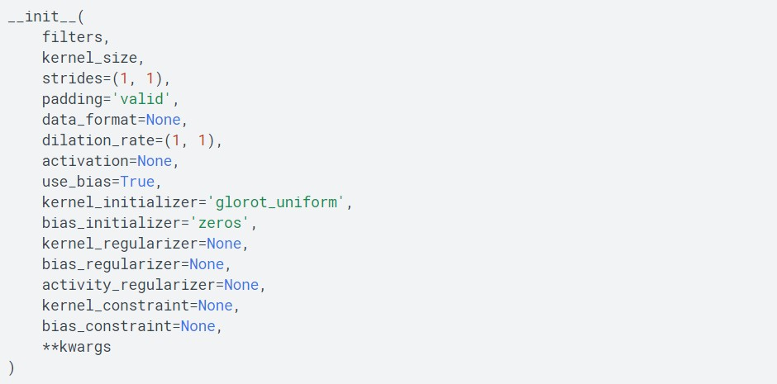
tf.keras.layers.Conv2D

Slide 33
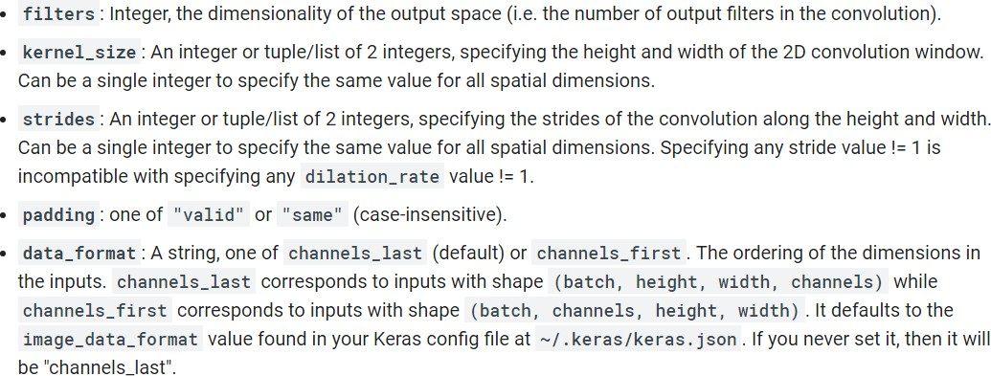
tf.keras.layers.Conv2D

Slide 34
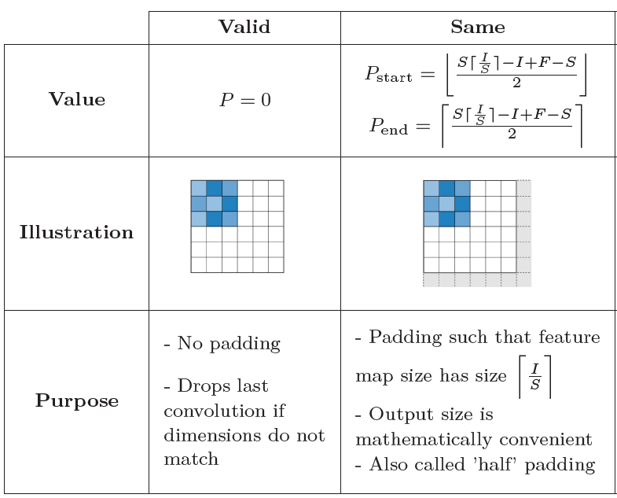
Padding – SAME vs VALID

Slide 35
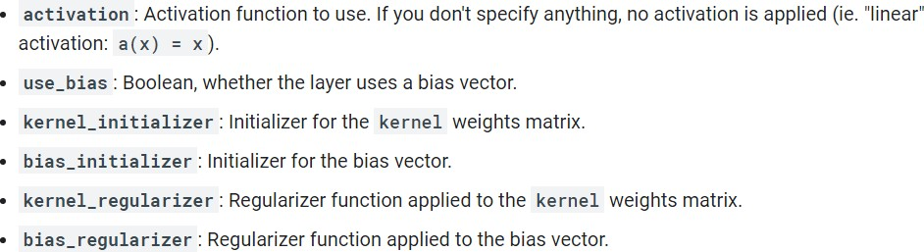
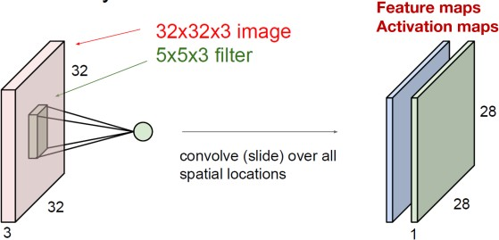
tf.keras.layers.Conv2D
kernel dimension : {height, width, in_channel, out_channel} Ex) {5, 5, 3, 2}

Slide 36
Importing Libraries & Enable Eager Mode
import numpy as np
import tensorflow as tf
from tensorflow import keras
import matplotlib.pyplot as plt
print(tf. version ) print(keras. version )
tf.enable_eager_execution()

Slide 37
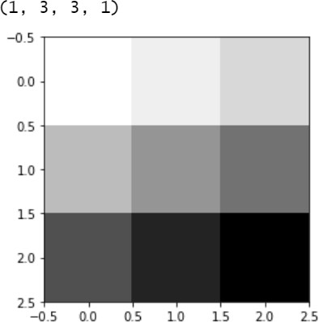
Toy Image
image = tf.constant([[[[1],[2],[3]],
[[4],[5],[6]],
[[7],[8],[9]]]], dtype=np.float32) print(image.shape) plt.imshow(image.numpy().reshape(3,3), cmap='Greys')
plt.show()

Slide 38
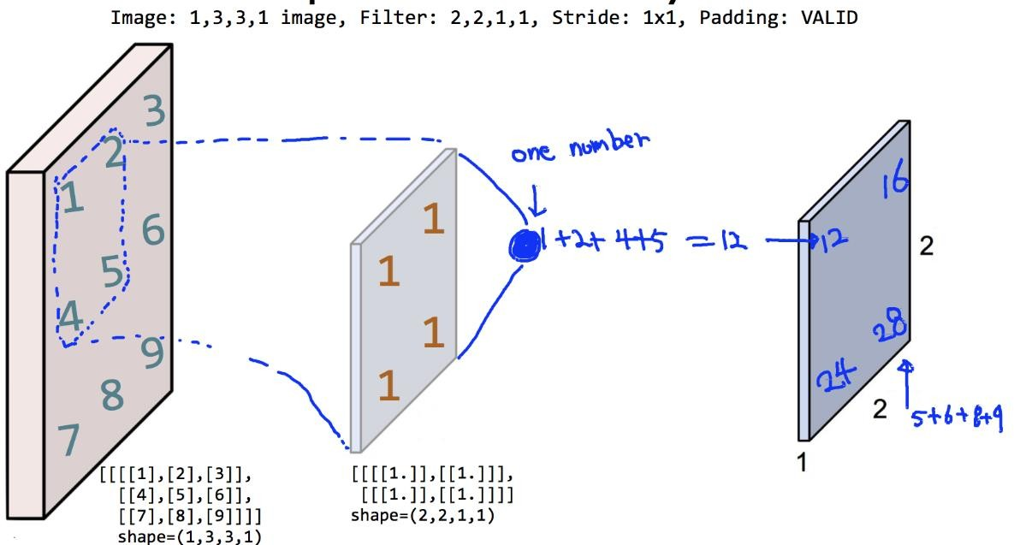
Simple Convolution Layer

Slide 39
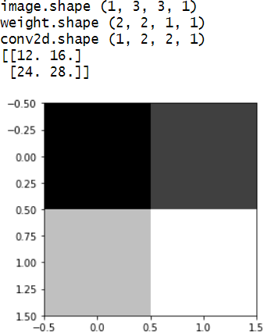
print("image.shape", image.shape) weight = np.array([[[[1.]],[[1.]]],
[[[1.]],[[1.]]]])
print("weight.shape", weight.shape)
weight_init = tf.constant_initializer(weight)
conv2d = keras.layers.Conv2D(filters=1, kernel_size=2, padding='VALID',
kernel_initializer=weight_init)(image) print("conv2d.shape", conv2d.shape) print(conv2d.numpy().reshape(2,2)) plt.imshow(conv2d.numpy().reshape(2,2), cmap='gray')
plt.show()

Slide 40
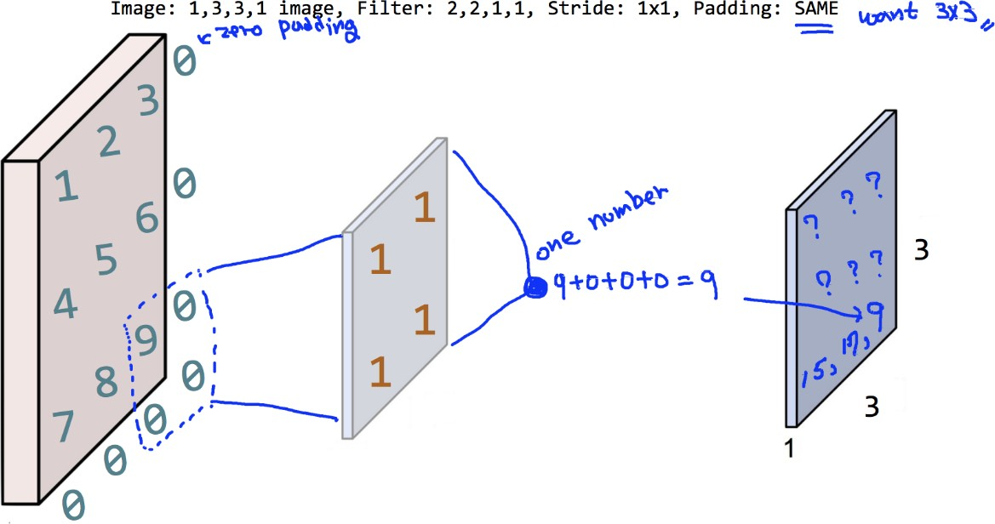
Simple Convolution Layer

Slide 41
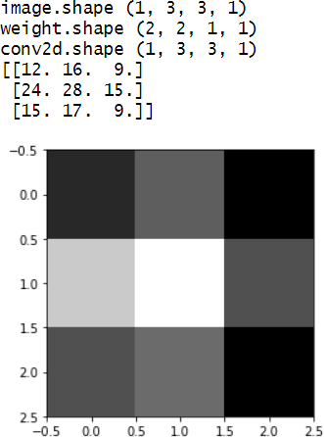
print("image.shape", image.shape) weight = np.array([[[[1.]],[[1.]]],
[[[1.]],[[1.]]]])
print("weight.shape", weight.shape)
weight_init = tf.constant_initializer(weight)
conv2d = keras.layers.Conv2D(filters=1, kernel_size=2, padding='SAME',
kernel_initializer=weight_init)(image) print("conv2d.shape", conv2d.shape) print(conv2d.numpy().reshape(3,3)) plt.imshow(conv2d.numpy().reshape(3,3), cmap='gray')
plt.show()

Slide 42
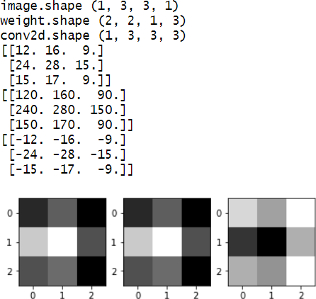
3 Filters (2, 2, 1, 3)
print("image.shape", image.shape)
weight = np.array([[[[1.,10.,-1.]],[[1.,10.,-1.]]],
[[[1.,10.,-1.]],[[1.,10.,-1.]]]])
print("weight.shape", weight.shape) weight_init = tf.constant_initializer(weight)
conv2d = keras.layers.Conv2D(filters=3, kernel_size=2, padding='SAME',
kernel_initializer=weight_init)(image)
print("conv2d.shape", conv2d.shape)
feature_maps = np.swapaxes(conv2d, 0, 3)
for i, feature_map in enumerate(feature_maps): print(feature_map.reshape(3,3))
plt.subplot(1,3,i+1), plt.imshow(feature_map.reshape(3,3), cmap='gray') plt.show()

Slide 43
What’s Next?
CNN Basics – Pooling

